Slide 1



Alanah Angus, Alex Grushkin, Yiqi Liang, Tobias Manayath, Diego Martinez
Notes:
ALL

Slide 2
Agenda
Our Purpose
Virtual Pantry
Recipe Generator
Shopping List
1
2
3
4
Security
6
Project
Reflection
7
Demo
5
Notes:
Tobias

Slide 3
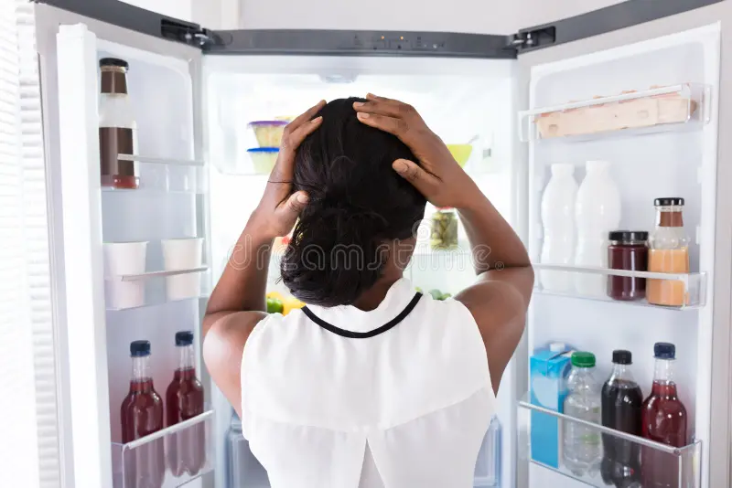

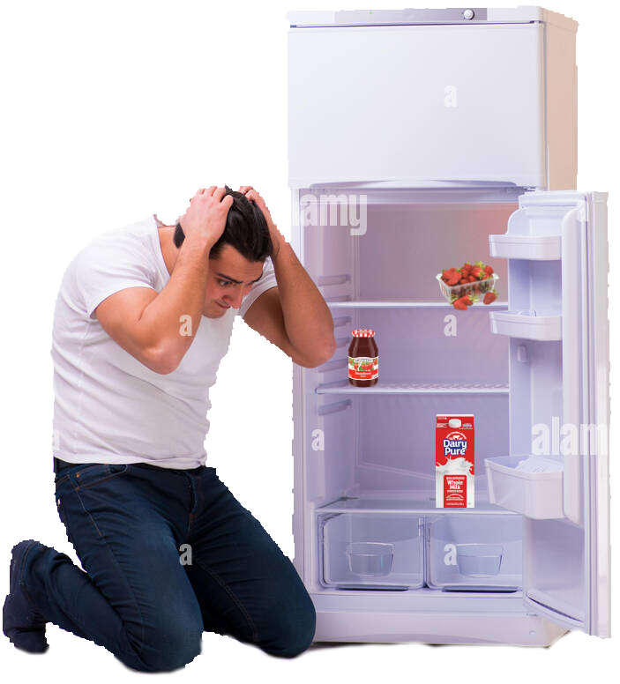
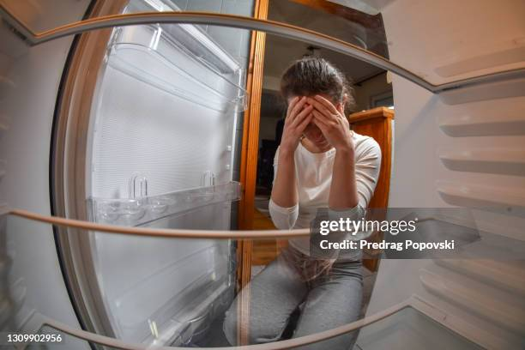

Has this ever
happened to you?
(pantry not shown)
Notes:
Alex

Slide 4


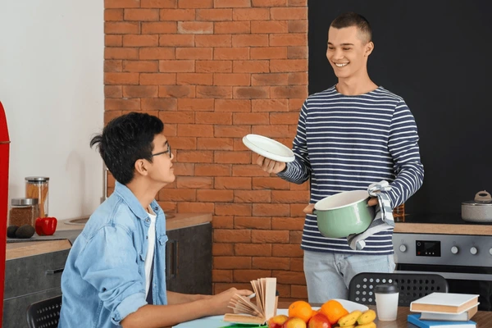
Your Personal Garde Manger
| MEET OUR USERS
David's Story
Winona's Story
Todd's Story
Stay-at-home father of three
Does meal prepping at the start of each week
Goes to the grocery store every Saturday
Businesswoman who is frequently in meetings
Has little to no time to ponder recipes
Uses an app to get groceries delivered when she runs out
College Sophomore living in an on-campus dorm
Owns a mini-fridge
Cooks meals twice a week in a communal kitchen
Notes:
Yiqi

Slide 5
Our Implementation
of Garde Manger

Slide 6
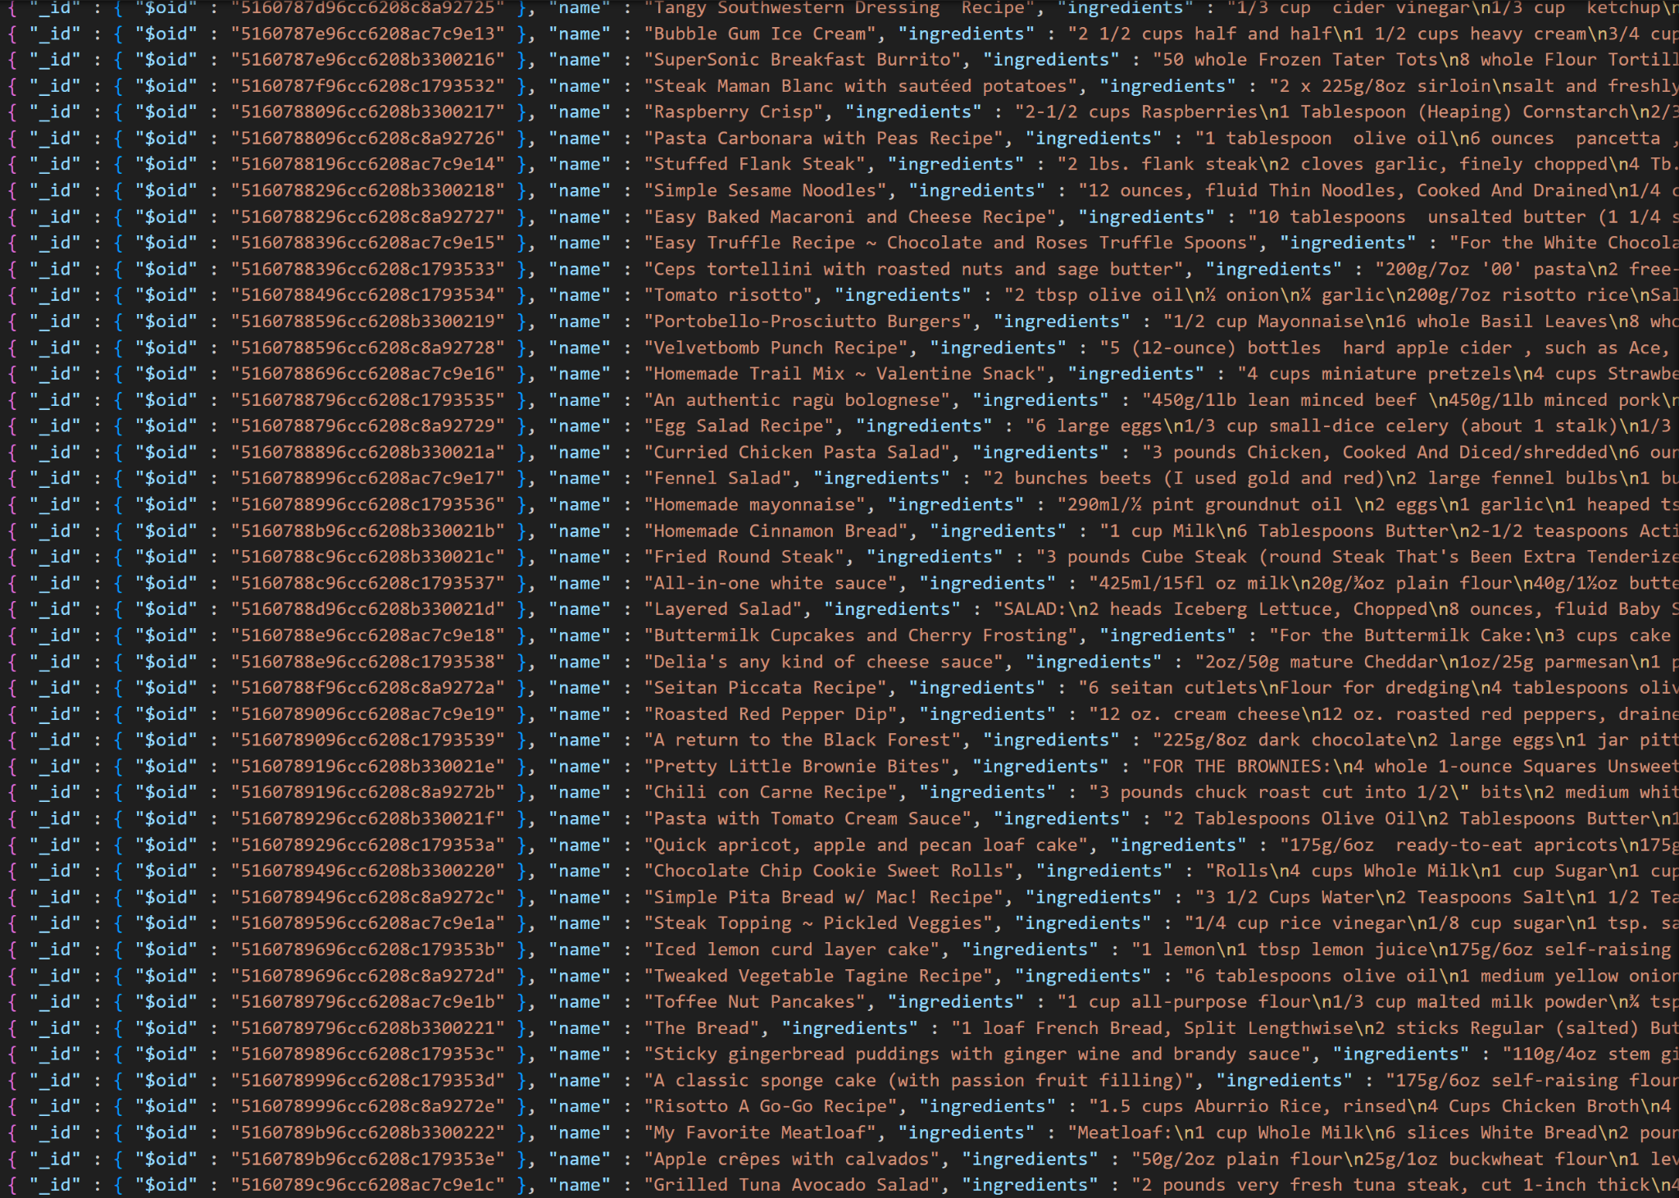
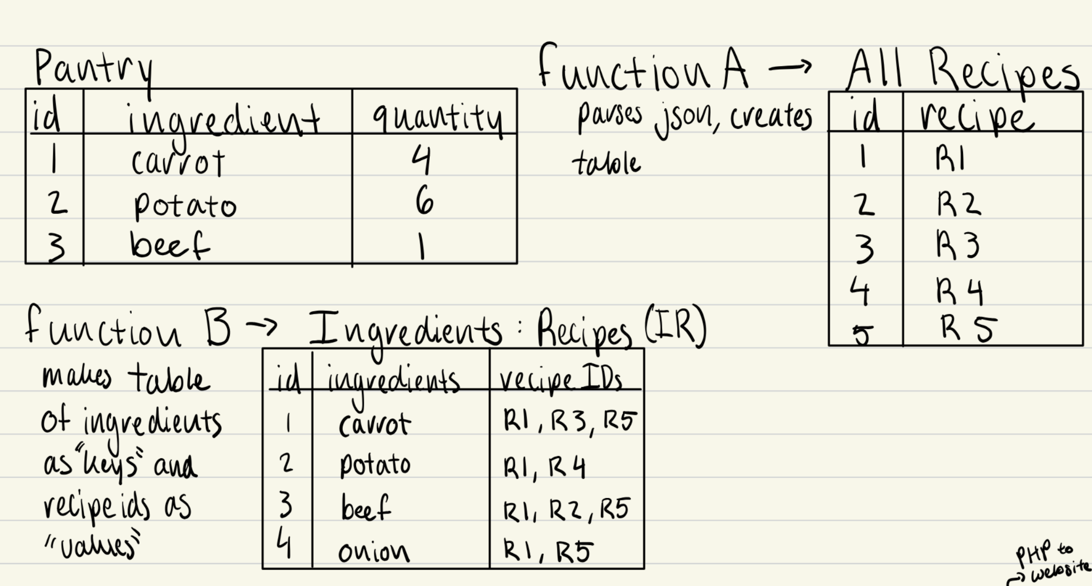
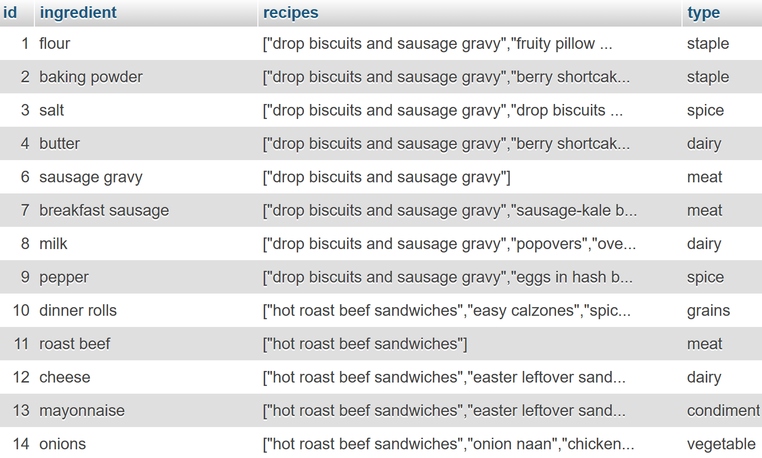
Virtual Pantry
API search → Open Recipes Database
JSON cleanup
Automated extraneous variable sifting
Manual parsing for consistency across records
Recipe & RecipeIngredients table setup (SQL)
Categorizing ingredients into food groups
Implementing checkboxes and syncing with user pantry table
Notes:
Alanah

Slide 7
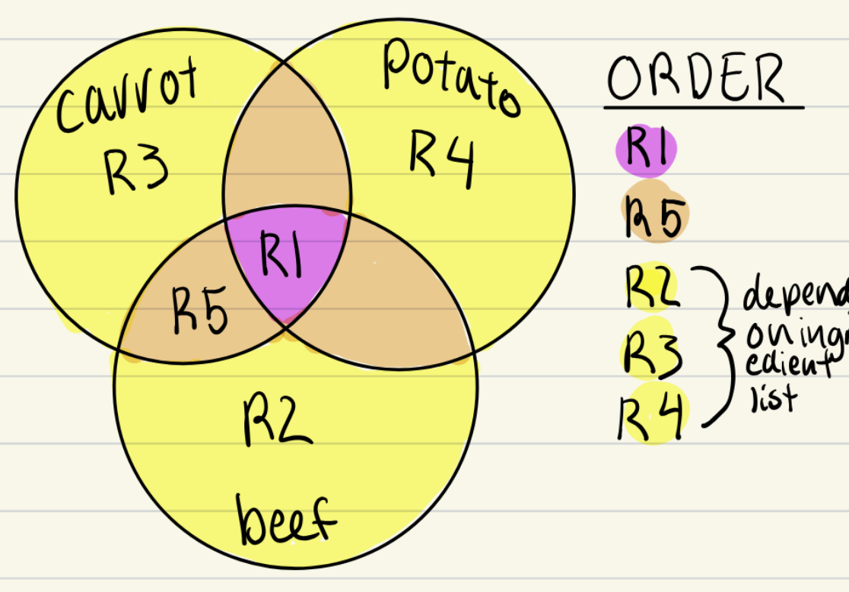
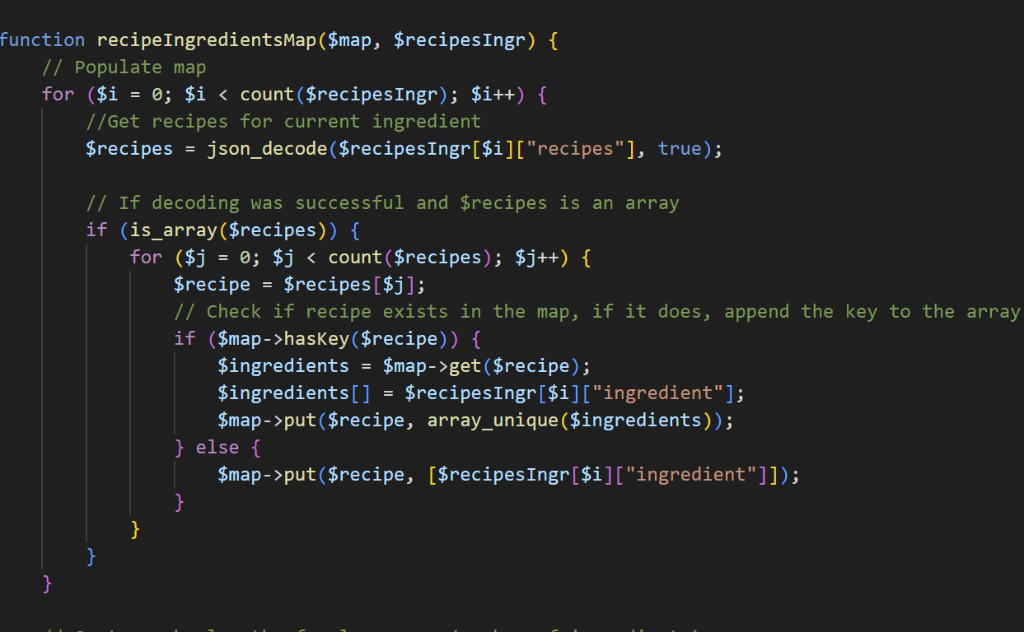
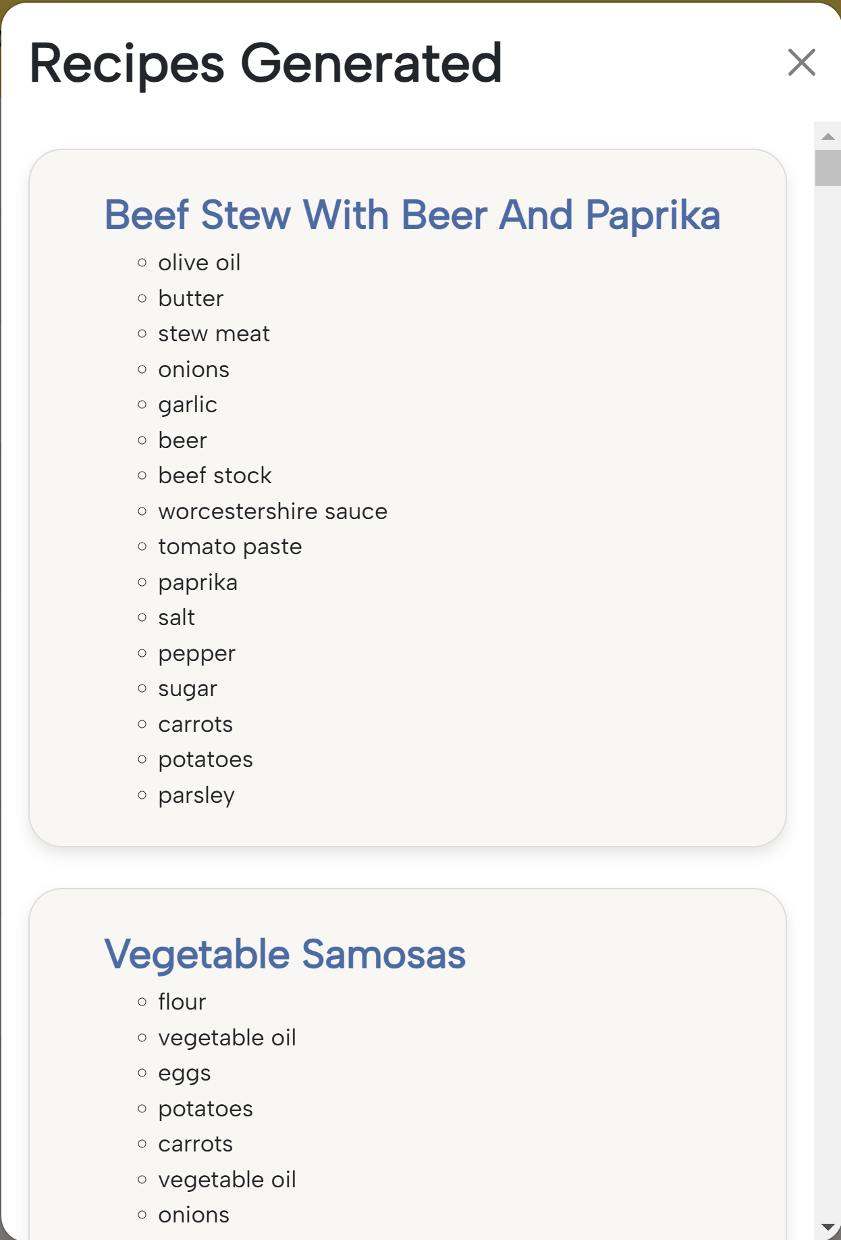
Recipe Generator
Sorting criteria: recipes that have the most pantry ingredients and do not have blacklisted ingredients
Form of pantry ingredients -> POST
Sorted using maps and arrays
Displayed on Pantry Page as a modem
Notes:
Alex

Slide 8
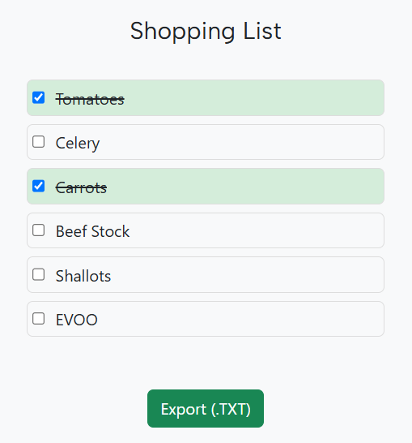
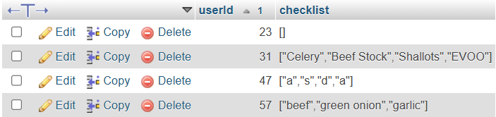
Shopping List
Javascript → DOMContentLoaded
fetchList()
saveList()
addItemToDOM()
exportList()
Notes:
Diego

Slide 9
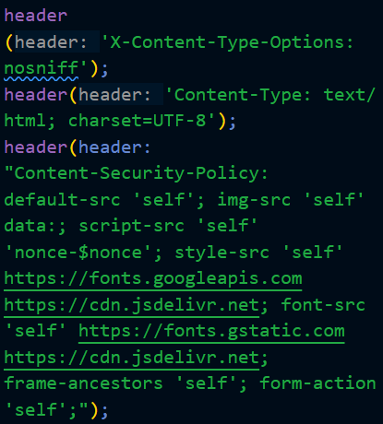
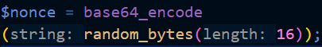
Security
Argon-2D Password Encryption
Content Security Headers
Nonces for Inline JS and CSS
CSRF Tokens for sensitive data
Session management
Timing out sessions
Proper SQL usage
Server Management
Notes:
Alanah

Slide 10

Development Obstacles
Despite parsing, ingredient lists had irregularities
Confusion regarding branch syncing and different home directories
While working on backend, we didn’t have enough frontend ready to test it with
Allowing Bootstrap, Google Fonts, jQuery with our Content Security Policy
API errors and decrepit links
Notes:
Alanah

Slide 11
Project Insights
Apache2 Dynamically Linked Libraries PHP Configuration
Argon-2D Hashing Encryption Salts Response Headers
Bootstrap Classes Error Codes Scalable Vector Graphics
Branching Favicons Scrum
Branding Design Git Commands Searchbar Implementation
Content Security Policy Input Sanitization Sessions
CSRF Tokens Input Validation SQL Queries
CSS Animations Merge Conflicts UI/UX
CSS Custom Properties Modals User Testing
Database Management Nonces Version Control
Directory Browsing Parsing XAMPP
DS Extension PHP Associative Arrays XHR Requests
Notes:
Diego - security, graphics/ui/ux, server-client connections
18 merge pull requests, 540 commits to our repo (common to find conflicts) (most commits 212 week of dec 1st)
Xampp useful for speeding up php development, less branch switching
Large database management, multiple databases referencing userid (+ session management)
Css custom properties using bootstrap
Session starts on page, times out after 30 minutes

Slide 12








Future Implemenations
Ingredient Substitutions
Ingredient Measurements
Conversions
Portion Scaling
Forgotten Password
Internal Recipe Display
Recipe Ratings
Barcode Scanner
Improved Mobile Interface
Saved Recipes
Notes:
Tobias

Slide 13
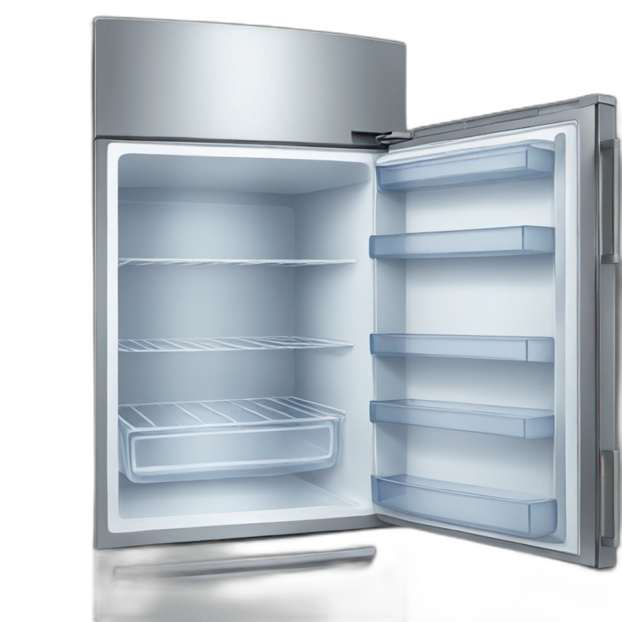

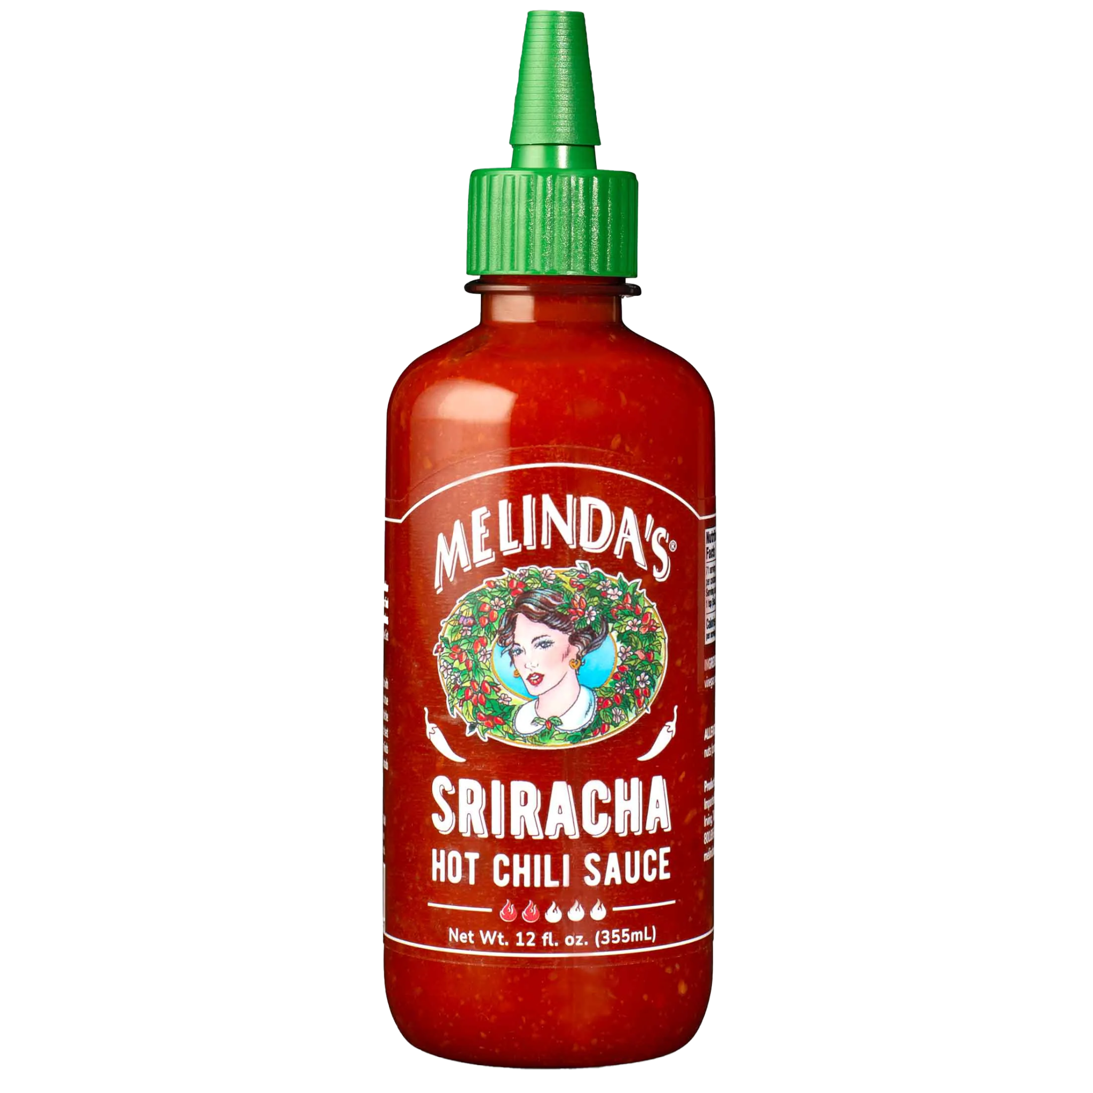
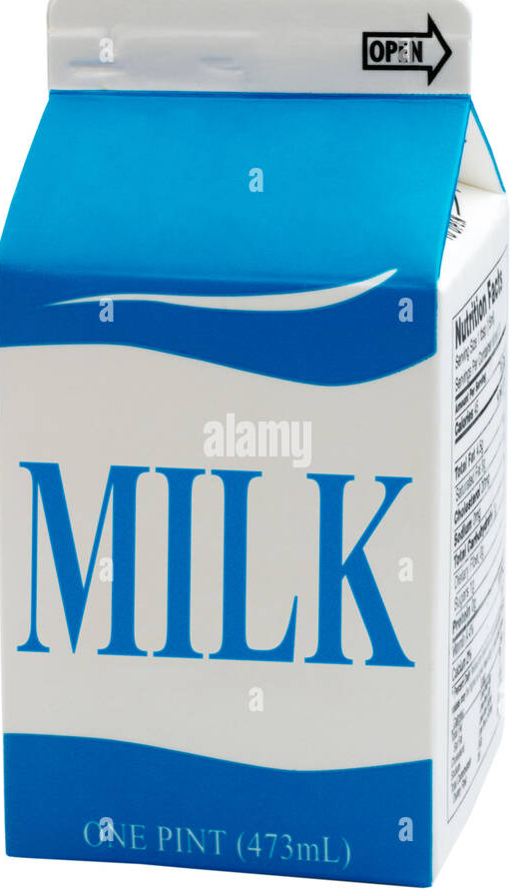
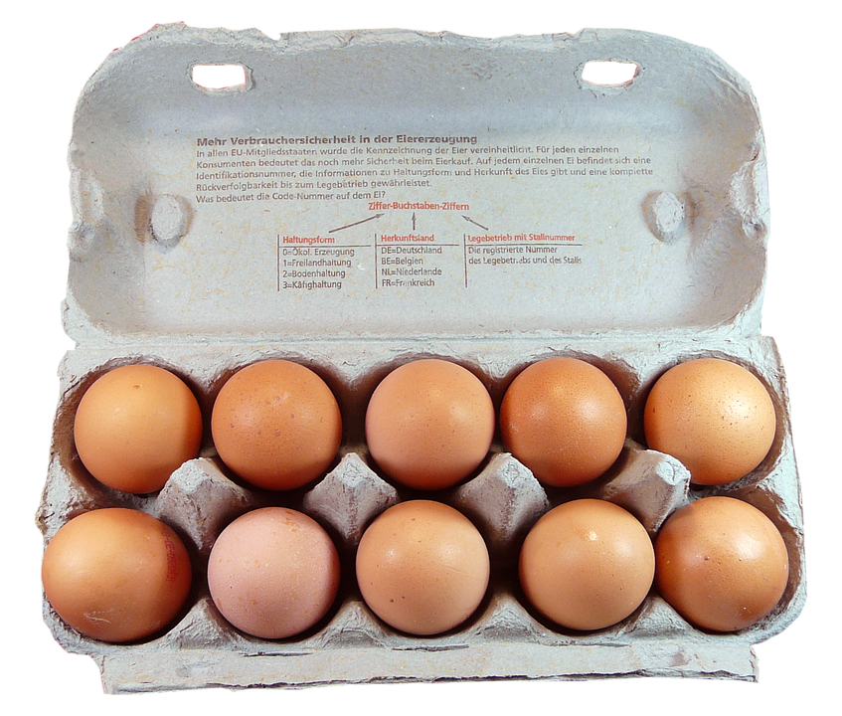


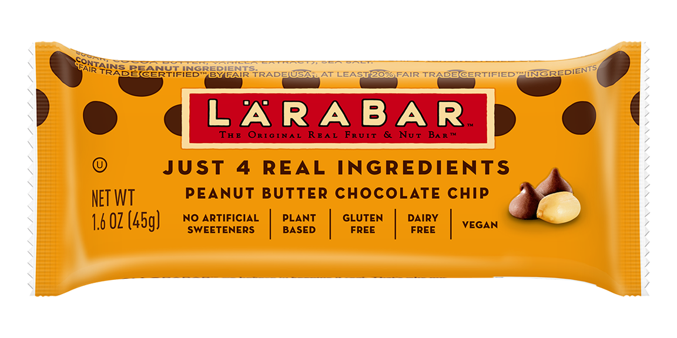
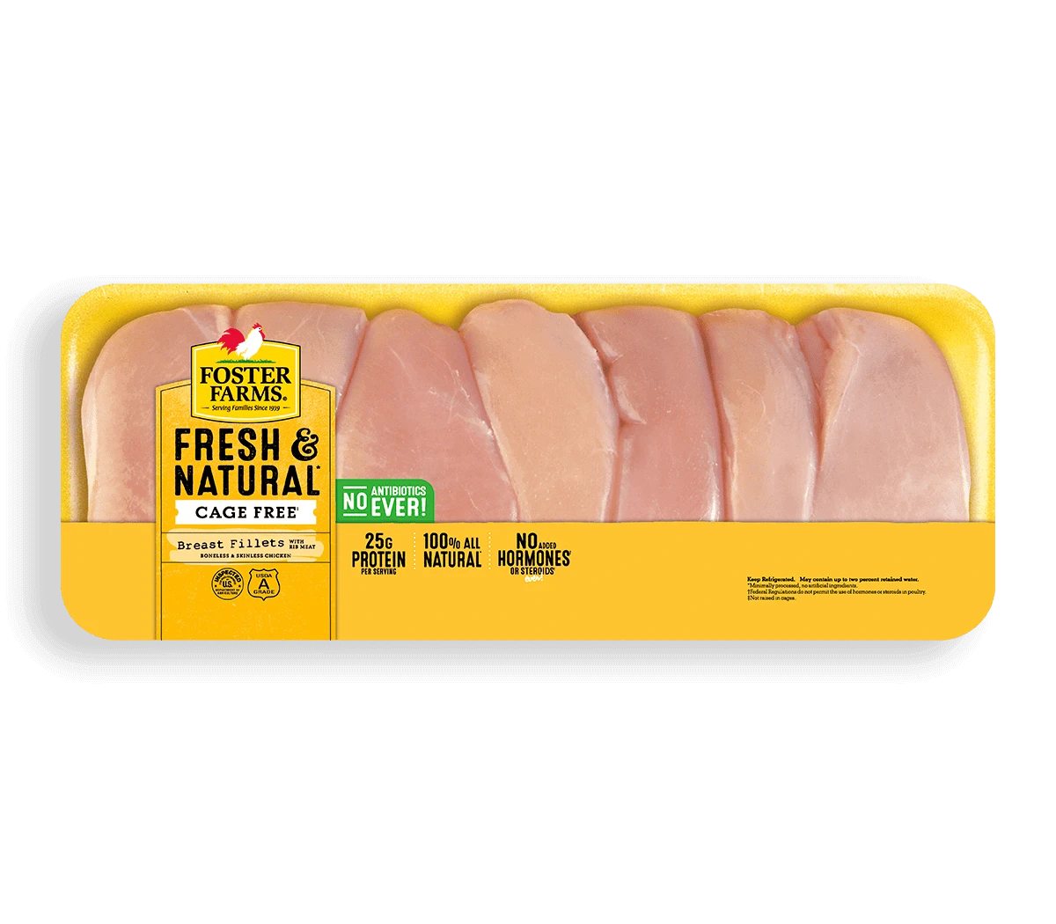
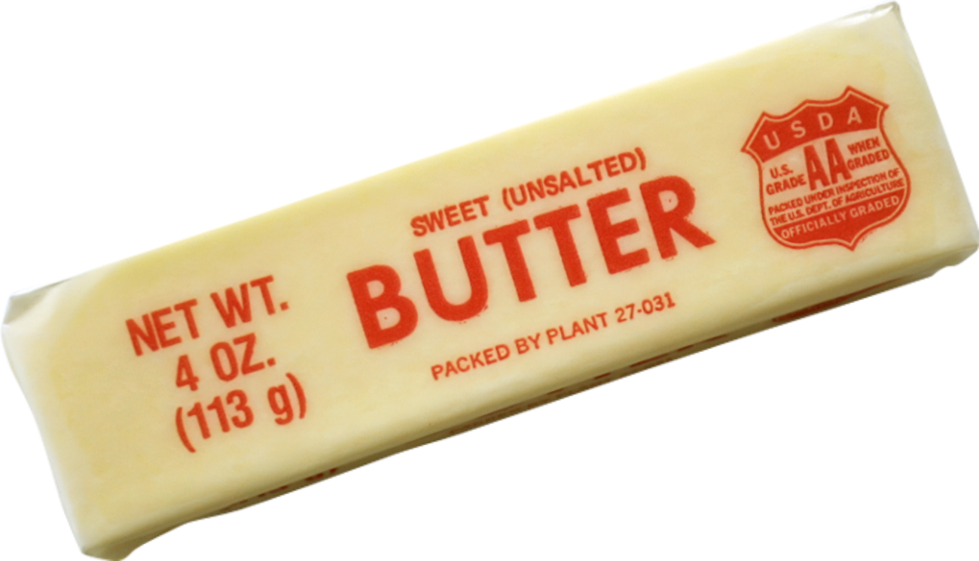

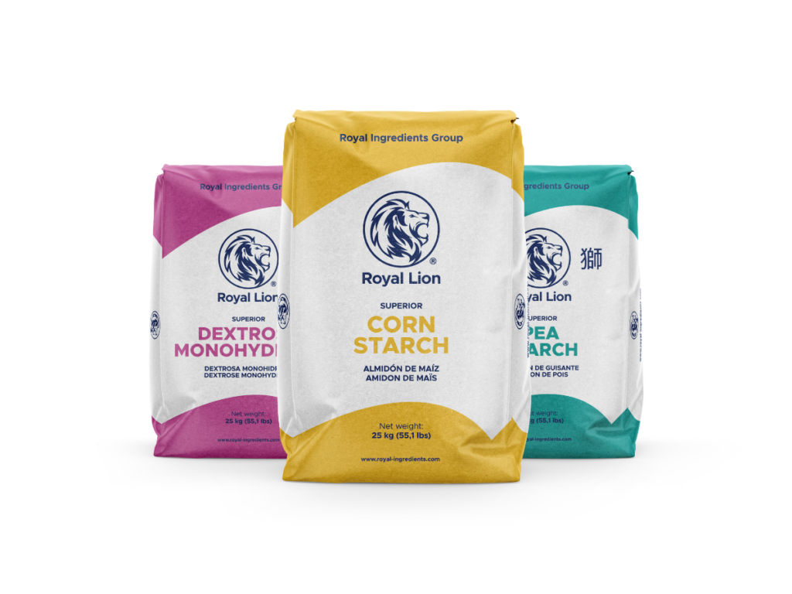


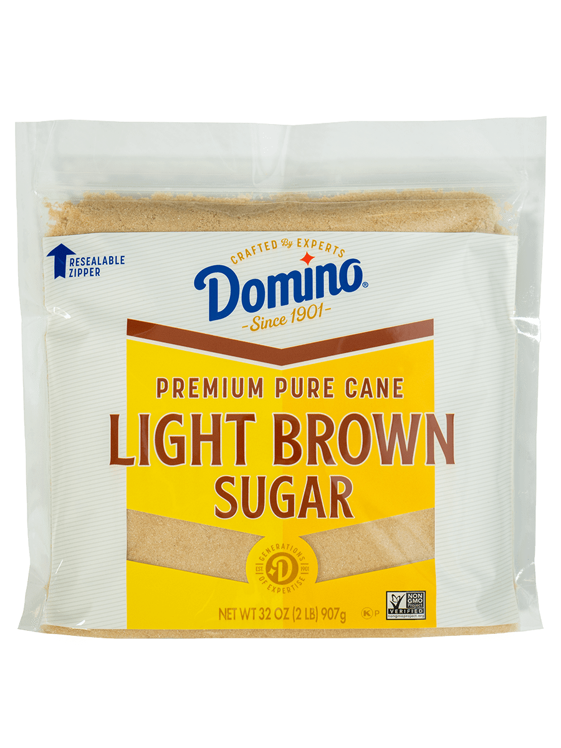
Garde Manger Demo
Notes:
Alex

Slide 14

Any Questions?

